Slide 1
Single-cell RNA-sequencing
26 mARCH & 2 APRIL 2025

Slide 2
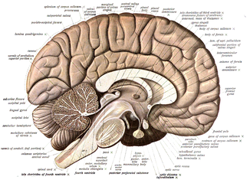
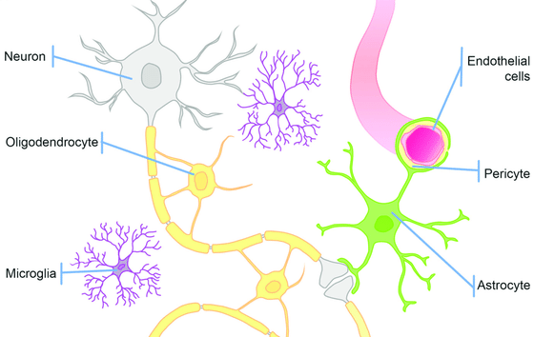
The brain is an extremely heterogeneous structure
Carpanini, Torvell, & Morgan (2019)

Slide 3
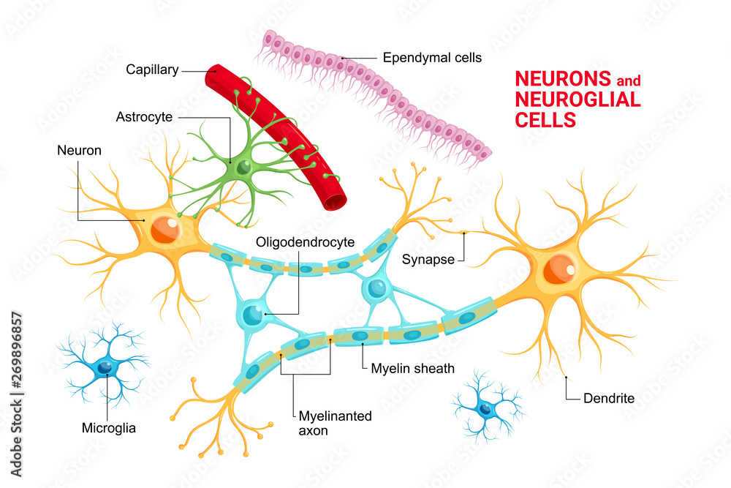
Major cell classes in the brain
Neurons
Major electrically active cells, responsible for signal processing and propagation in the brain
Excitatory neurons
Generally activate other neurons, can have long range projections to different brain regions
Inhibitory neurons
Generally repress activity in other neurons, tend to be locally projecting
Astrocytes
Involved in blood-brain barrier maintenance, neurotransmitter clean-up, neuronal health maintenance
Microglia
Resident innate immune cells in the brain, responsible for surveillance, synaptic pruning, and brain health
Ependymal cells
Line the brain ventricles, generate cerebrospinal fluid
Glia
Historically thought of as “support” cells, but have a wide array of functions related to overall brain health
Oligodendrocytes
Myelinate neuronal axons to allow for more efficient signal processing
Vascular cells
Involved in blood-brain barrier maintenance, ensure stability of vasculature in the brain

Slide 4
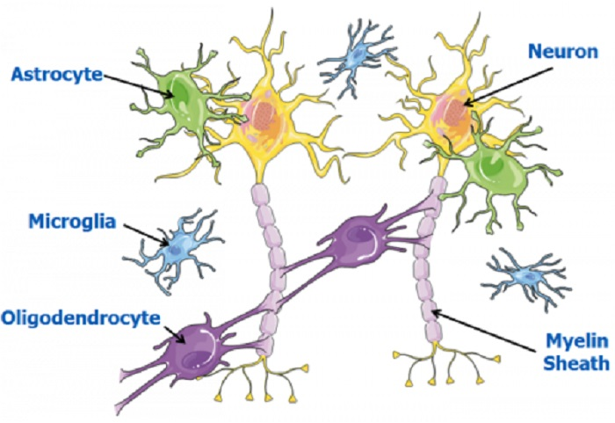
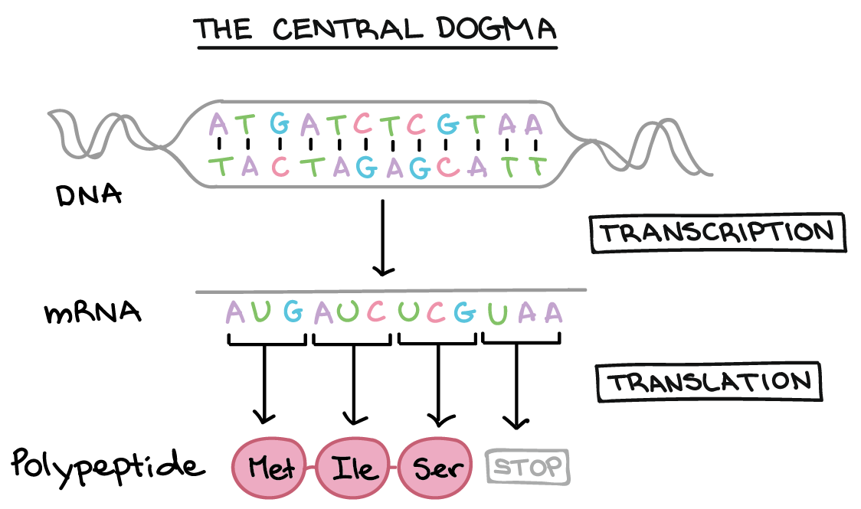
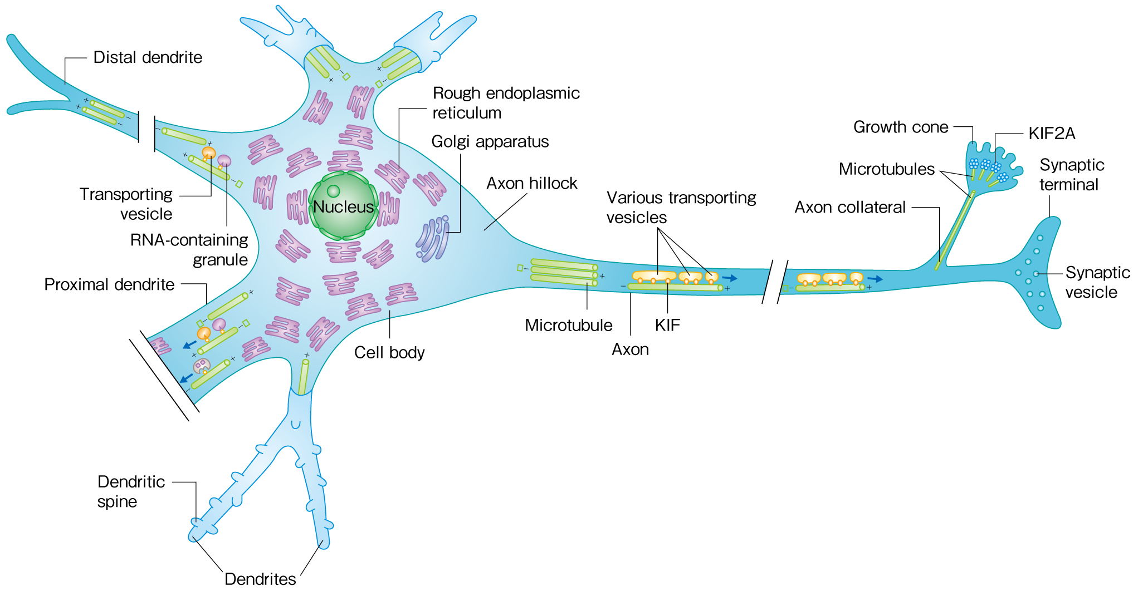
Molecular profiling of brain tissue
Hirokawa, 2018
Objective: Quantify mRNA (& protein) levels in brain tissue from individuals with and without disease

Slide 5
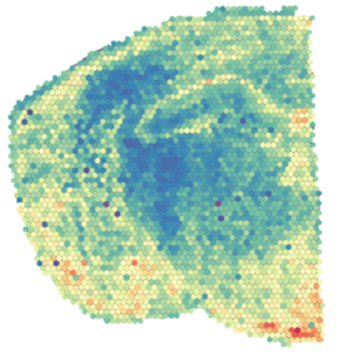
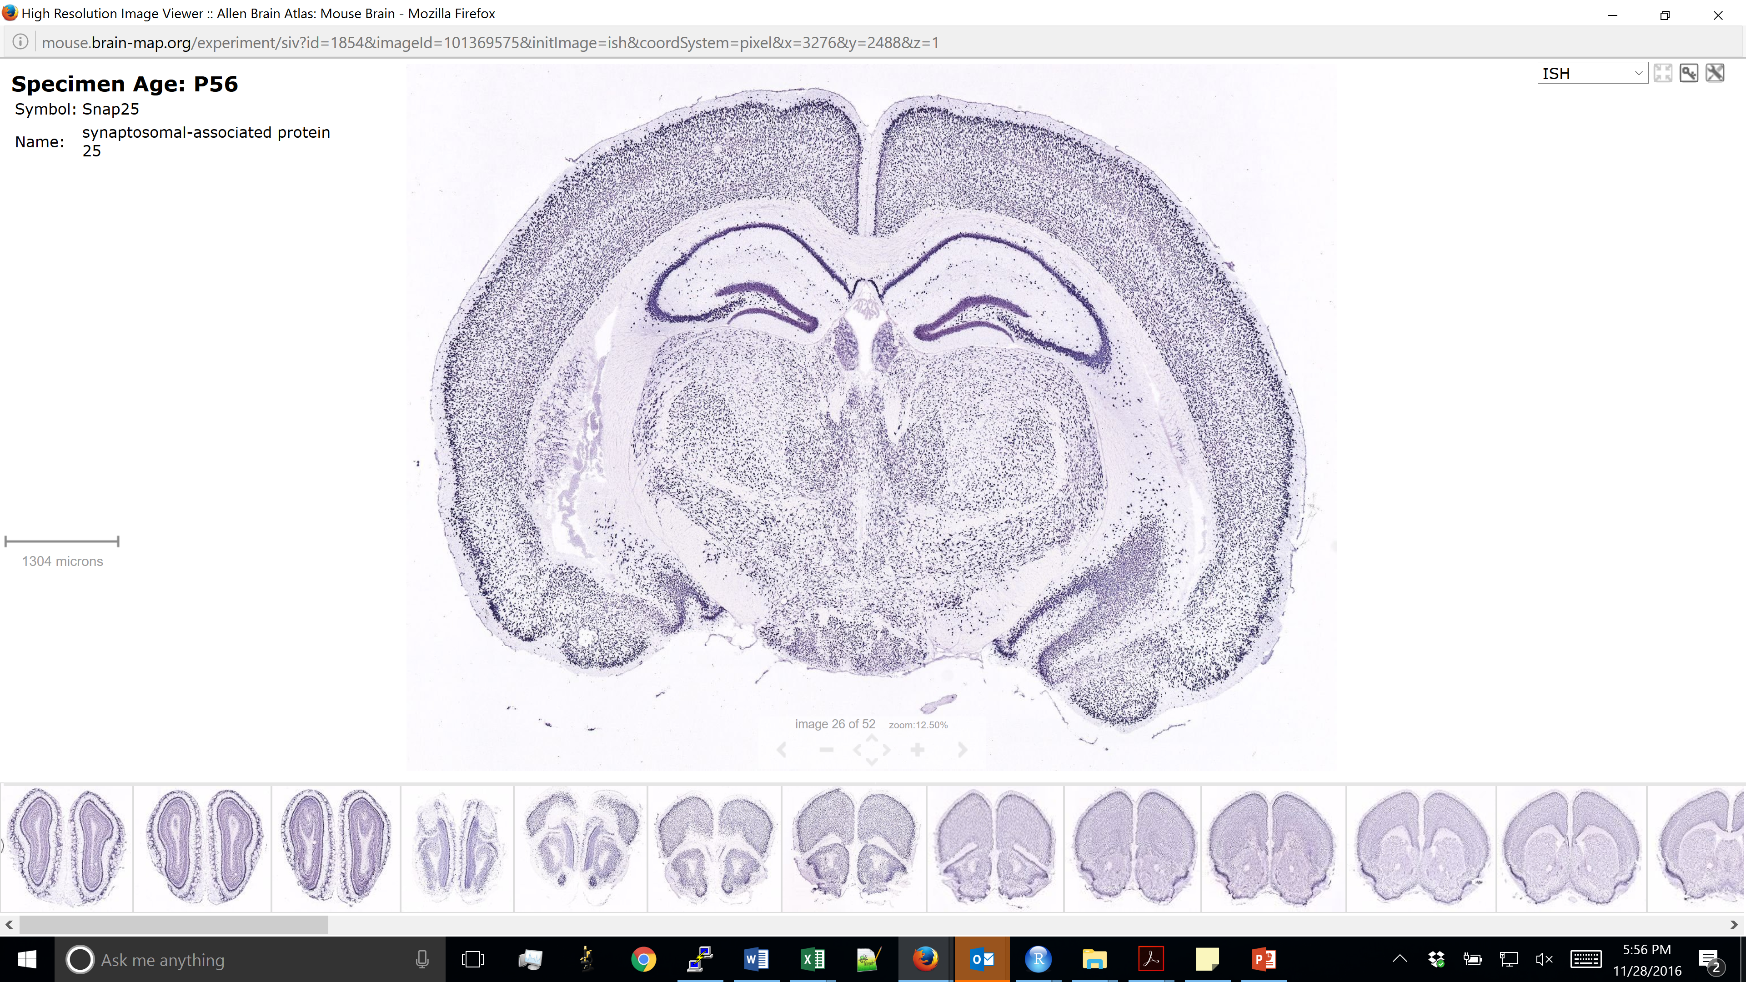
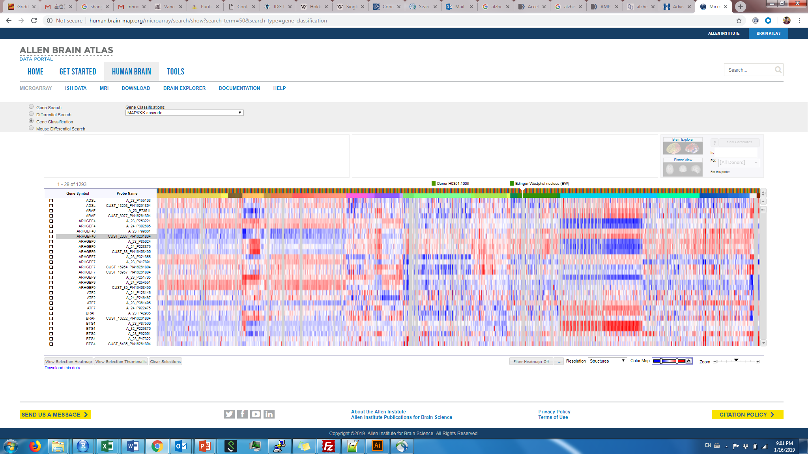
Molecular profiling methods
Method | ISH/IHC | RNA-sequencing
# of genes/proteins at once | ~1 – 5 (~500 with advanced methods) | ~10,000 – 20,000
Single-cell resolution | Yes | No
Spatial information | Yes | No
“Unbiased” (no pre-selection) | No | Yes
Single-cell RNA-seq
~1,000 – 10,000
Yes
No
Yes
Spatial transcriptomics
~1,000 – 10,000
No
Yes
Yes

Slide 6
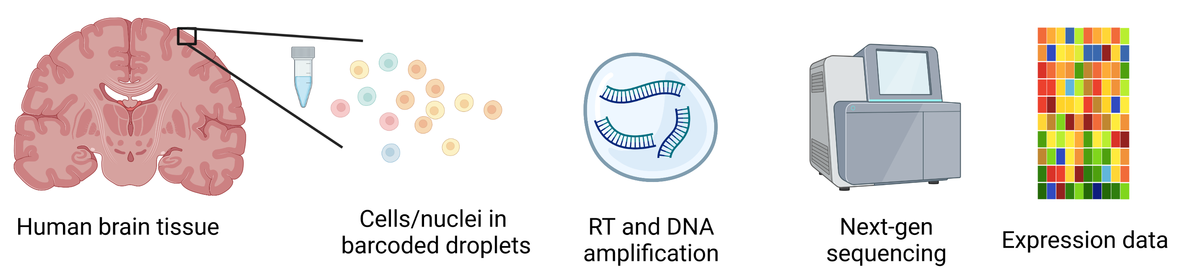
Bulk and single-cell/nucleus RNA-seq
Bulk RNA-seq | Single-cell/nucleus RNA-seq
More robust | Easier to identify cell type-specific signatures
Lower cost | Higher resolution
Can capture all RNA | Restricted to somatic or nuclear RNA
Tissue homogenization (bulk)

Slide 7
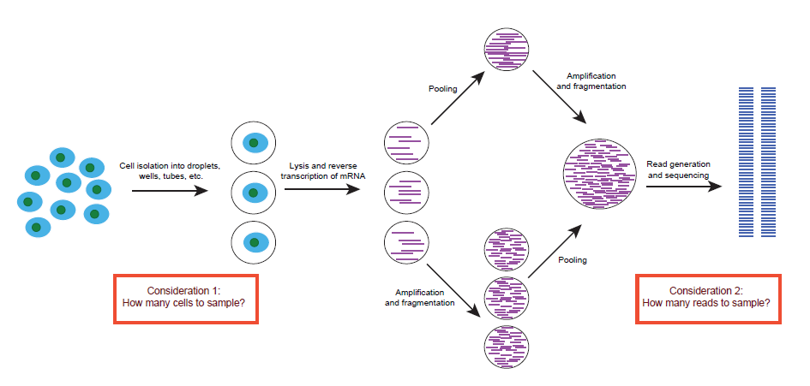
Single-cell RNA-seq workflow
Barcoded methods (e.g. 10x Genomics Chromium, Drop-Seq, InDrop, CEL-Seq, MARS)
Higher throughput
Only get 5’ or 3’ end of the transcript
Can account for amplification artifacts
Non-barcoded methods (e.g. SMART-Seq2)
Can obtain full-length transcripts
Higher sensitivity
Lower throughput

Slide 8
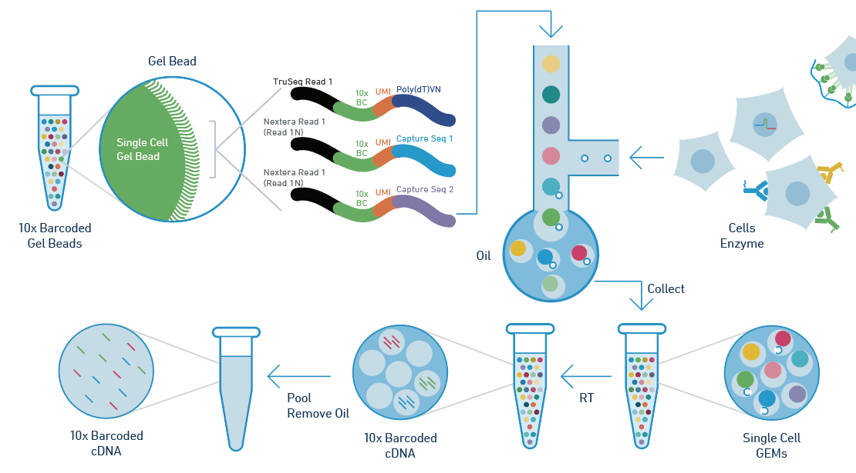
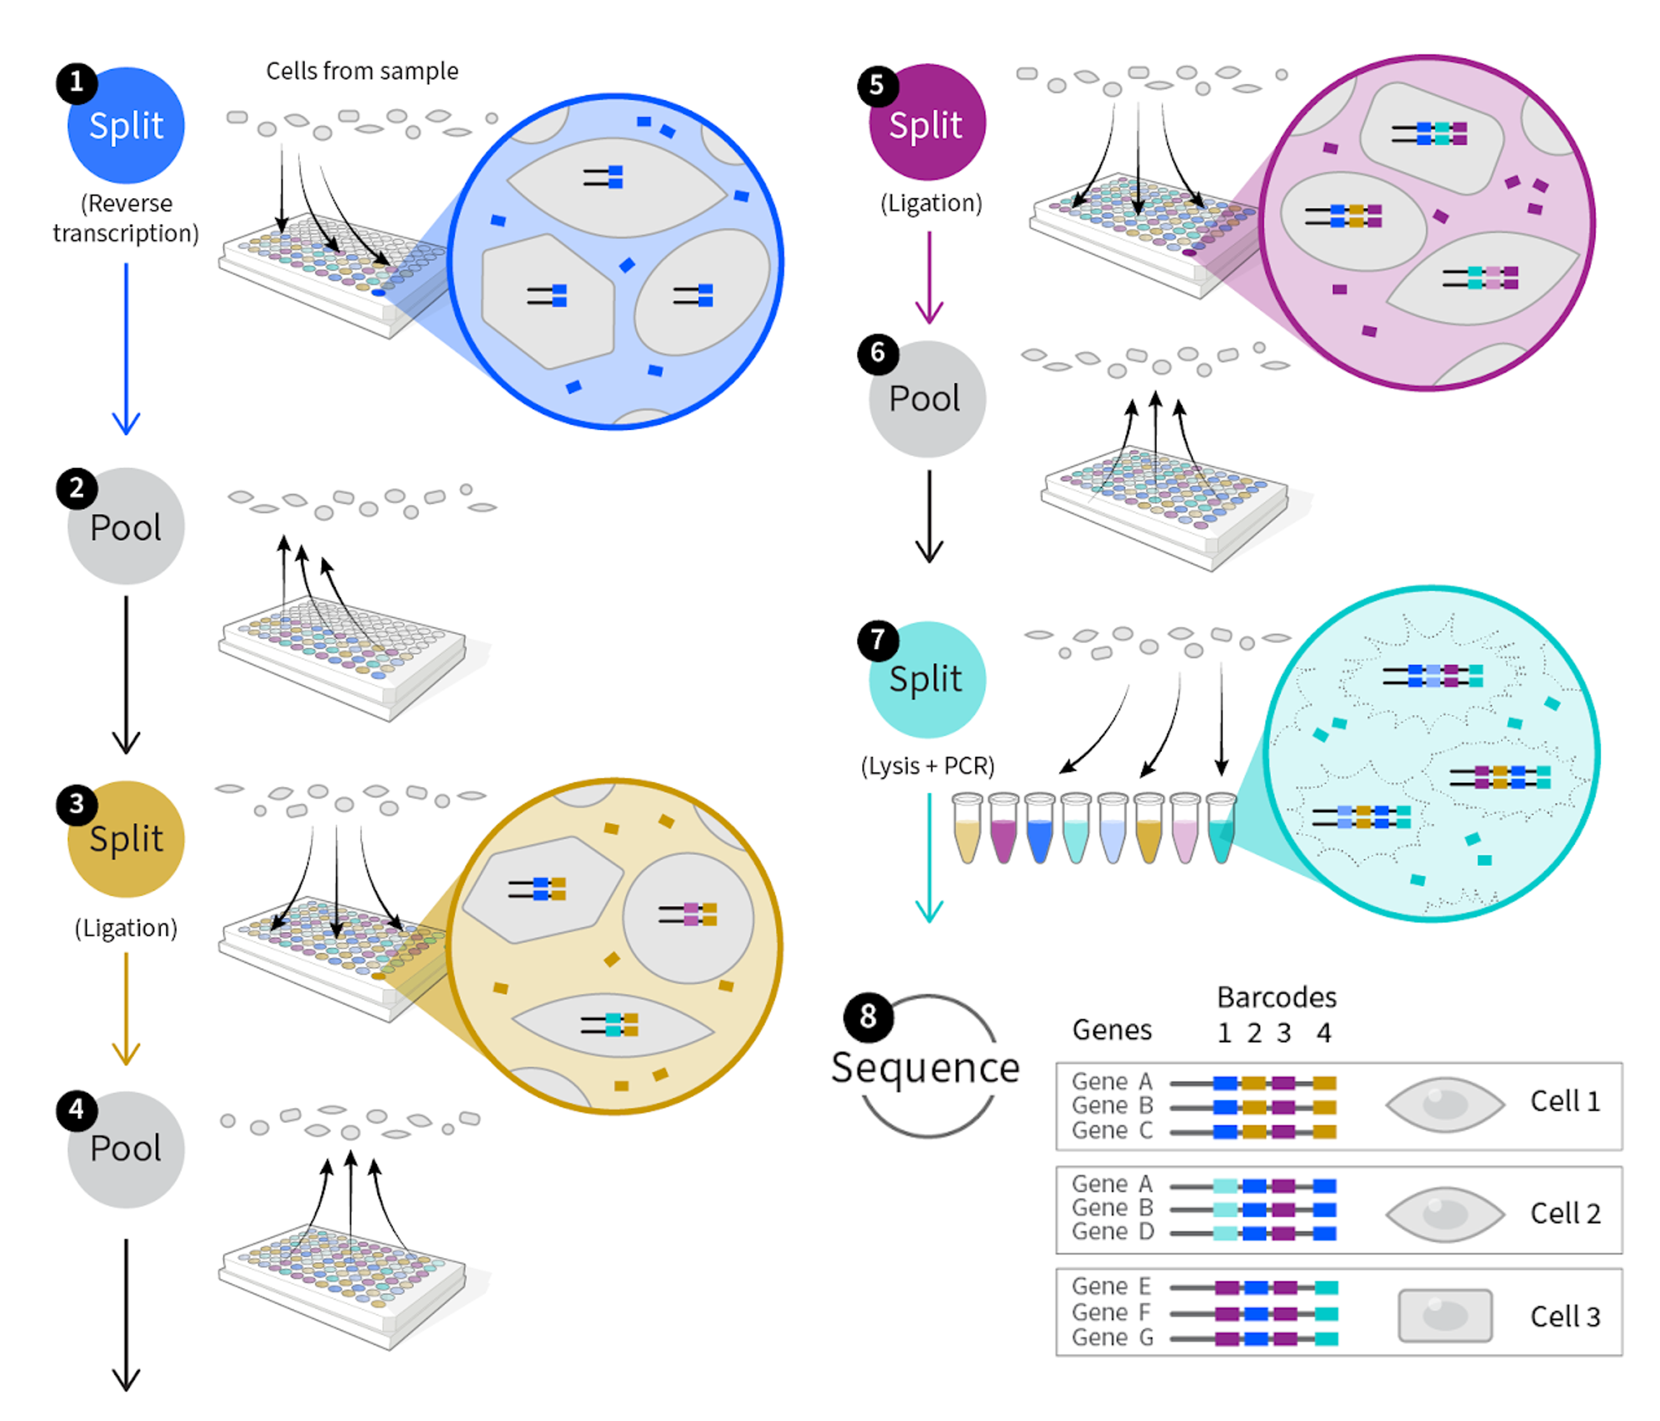
Single-cell RNA-seq barcoding
Droplet-based (barcodes are pre-generated)
Split-pooling (barcodes are combinatorially generated)
10x Genomics Chromium workflow, Drop-seq, InDrop
SPLIT-Seq, Parse Biosciences workflow

Slide 9
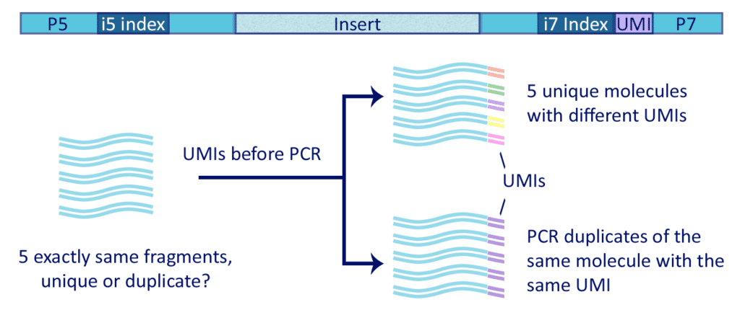
Unique Molecular Identifiers – counting transcripts
Kavaklioglu 2019

Slide 10

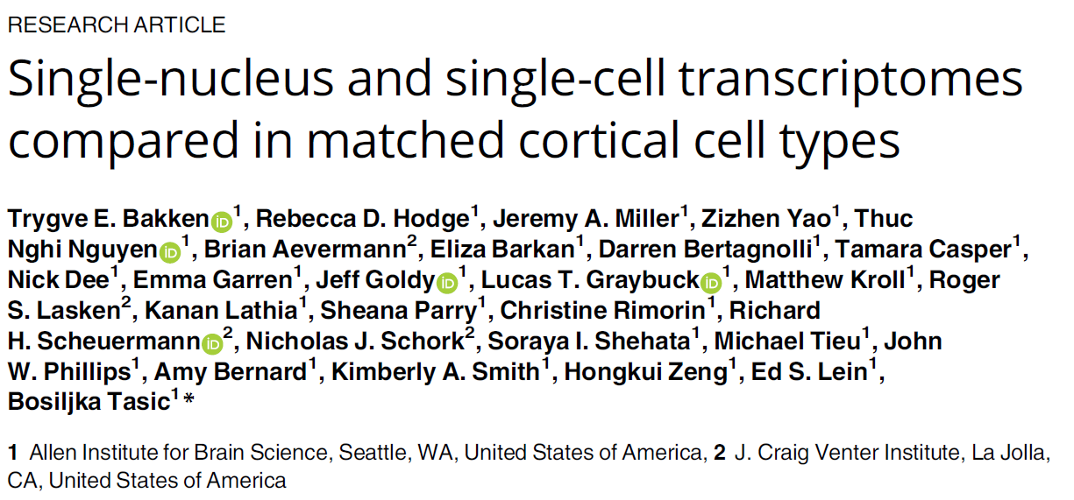
Single-cell vs. single-nucleus RNA-seq
Single-cell RNA-seq | Single-nucleus RNA-seq
Higher gene detection | Lower gene detection
Captures cytoplasmic transcripts | No cytoplasmic transcripts
Developed (so far) only for fresh human tissue | Feasible on frozen adult human brain tissue
So far, robust data only for microglia and astrocytes (with one exception in 2015) | Can obtain all canonical brain cell types
Strong survivability bias | Less survivability bias

Slide 11

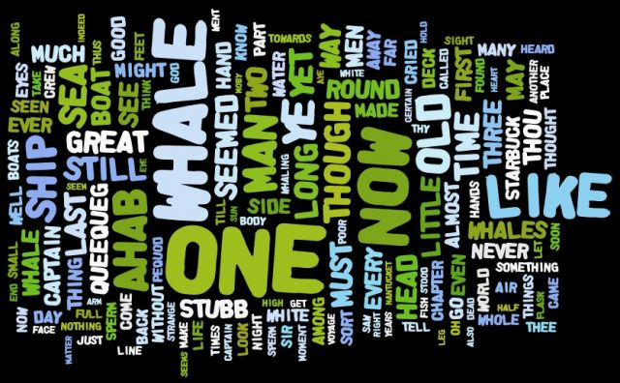

Pause: what does RNA-seq measure?
The Art of Clean Up, Ursus Wehrli

Slide 12
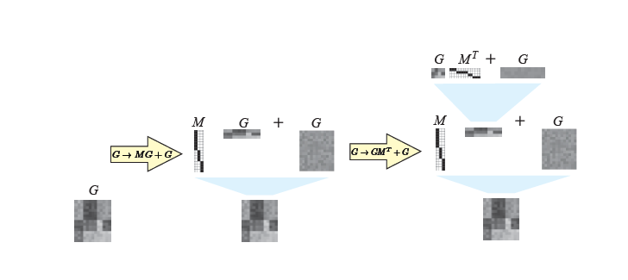
Analyzing single-cell RNA-seq data
The first major step in single-cell RNA-seq analysis methods try to solve a clustering (matrix reordering) problem
“Cell type” 1
“Cell type” 2
Grosse et al. 2012
“Cell type” 3
Menon 2017

Slide 13
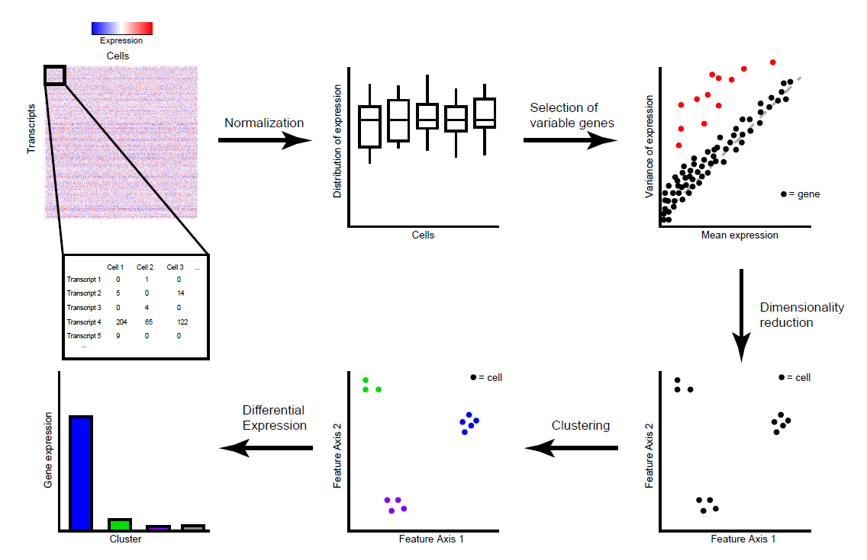
Standard analytical (clustering) workflow
Fundamental assumption:
Cell types are distinguished by coordinated differences in expression across multiple genes

Slide 14
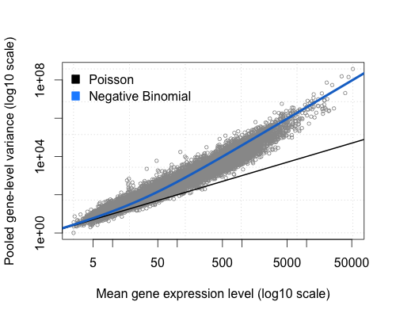
High-variance gene selection
Select genes based on dispersion (variance/mean) – keep genes that have high variance based on their mean
Why is this step important?

Slide 15
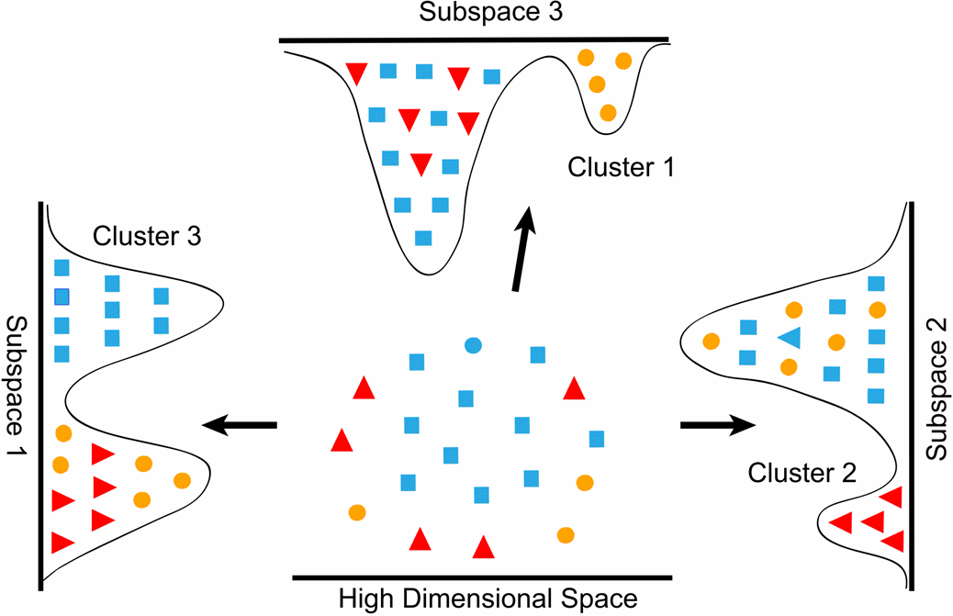
Dimensionality reduction
“Cell type” 1
“Cell type” 2
“Cell type” 3

Slide 16
Dimensionality reduction for visualization versus clustering
Dimensionality reduction for clustering
Often require >>2 dimensions
Distance metric needs to preserve local and global similarity/differences
PCA, Gene module analysis, autoencoder-based approaches
Dimensionality reduction for visualization
Need to work in 2 (or 3) dimensions
Distance metrics are often highly nonlinear, and non-interpretable over large differences
t-SNE, UMAP
If the approaches agree, great news!

Slide 17
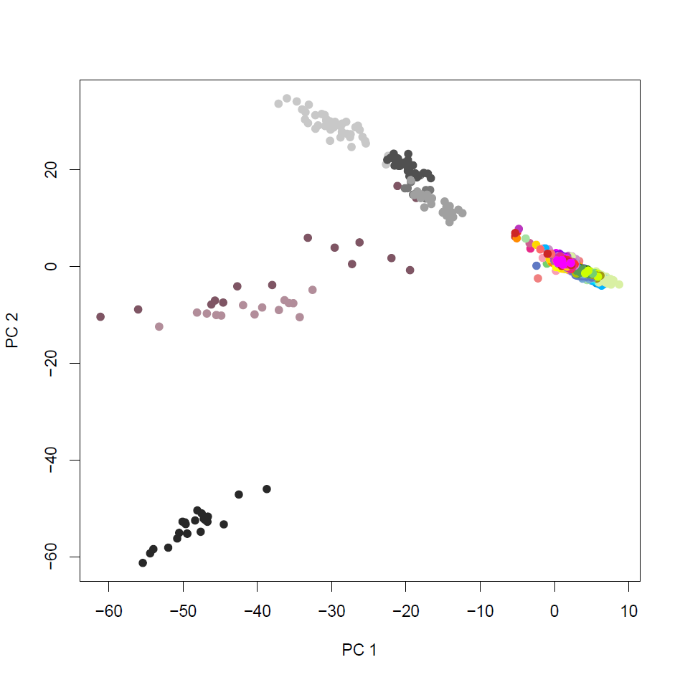
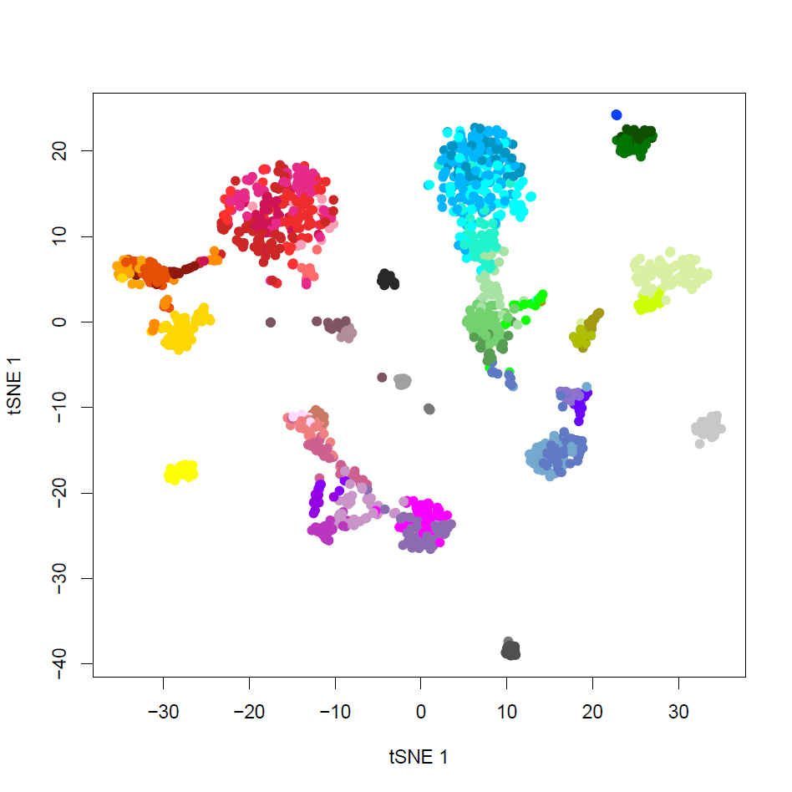
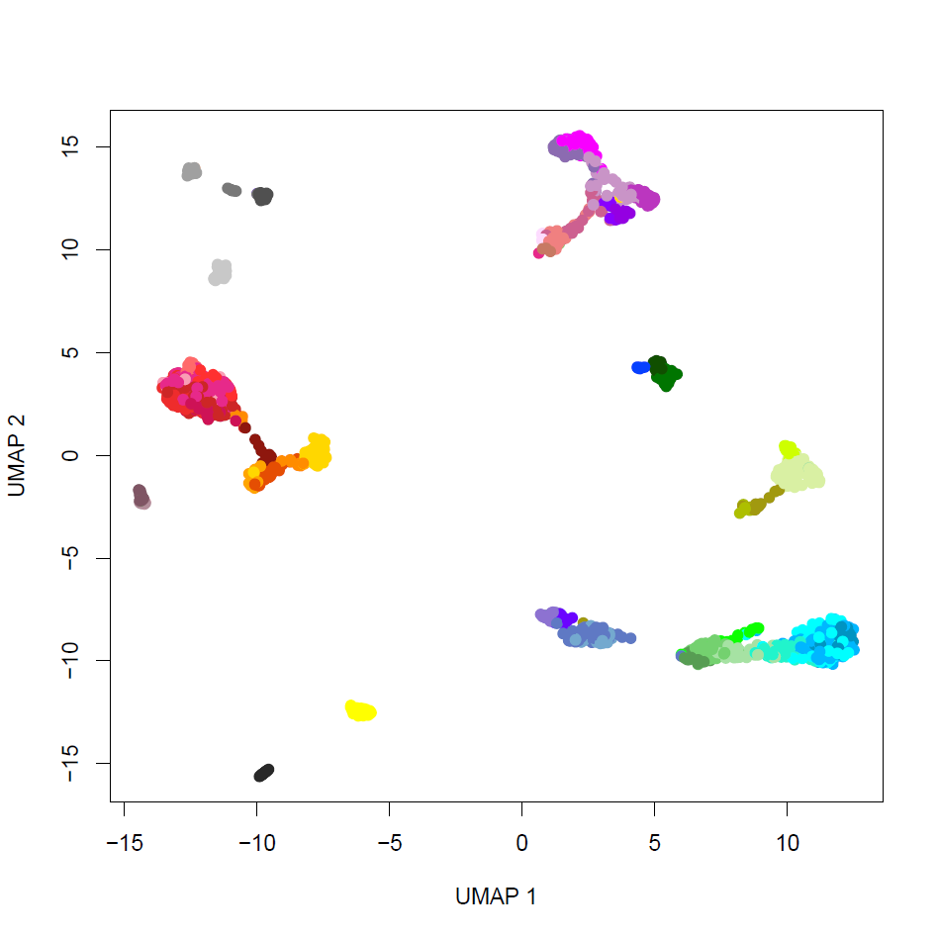
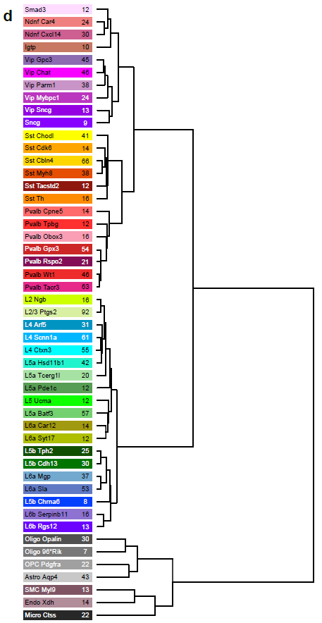



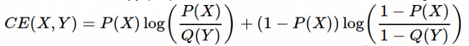
Dimensionality reduction methods
PCA with 2 PCs
tSNE
UMAP
Glutamatergic (Excitatory) Neurons
Nonlinear, preserves local structure
Nonlinear, preserves local structure and some aspects of global structure
GABAergic (Inhibitory) Neurons
Non-neuronal cells
High-dimensional “similarity”
Low-dimensional “similarity”
Minimize KL divergence
Minimize Cross-Entropy

Slide 18
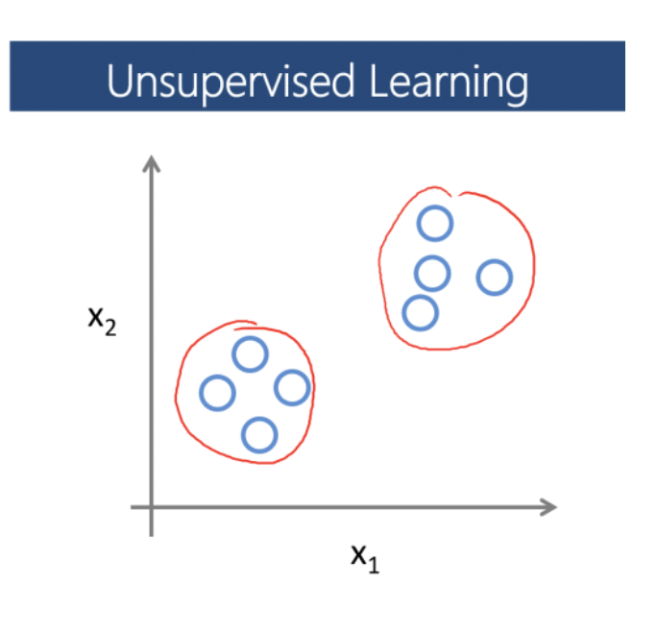
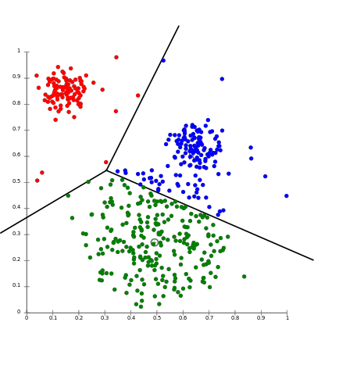
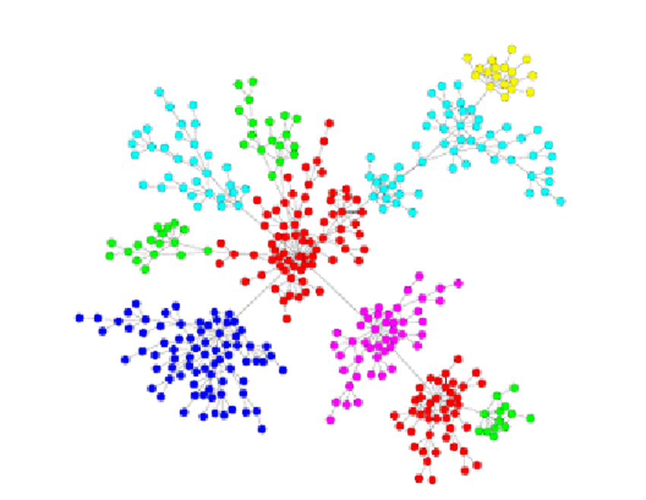
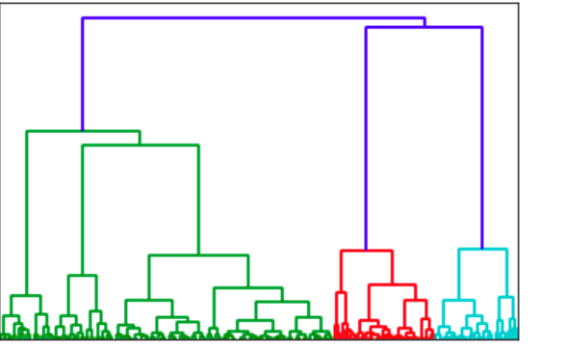
Clustering in reduced dimension space
Clustering requires:
A distance metric
An algorithm to assign elements to groups
For single-cell data:
Graph-based community detection methods
K-means
Hierarchical clustering

Slide 19
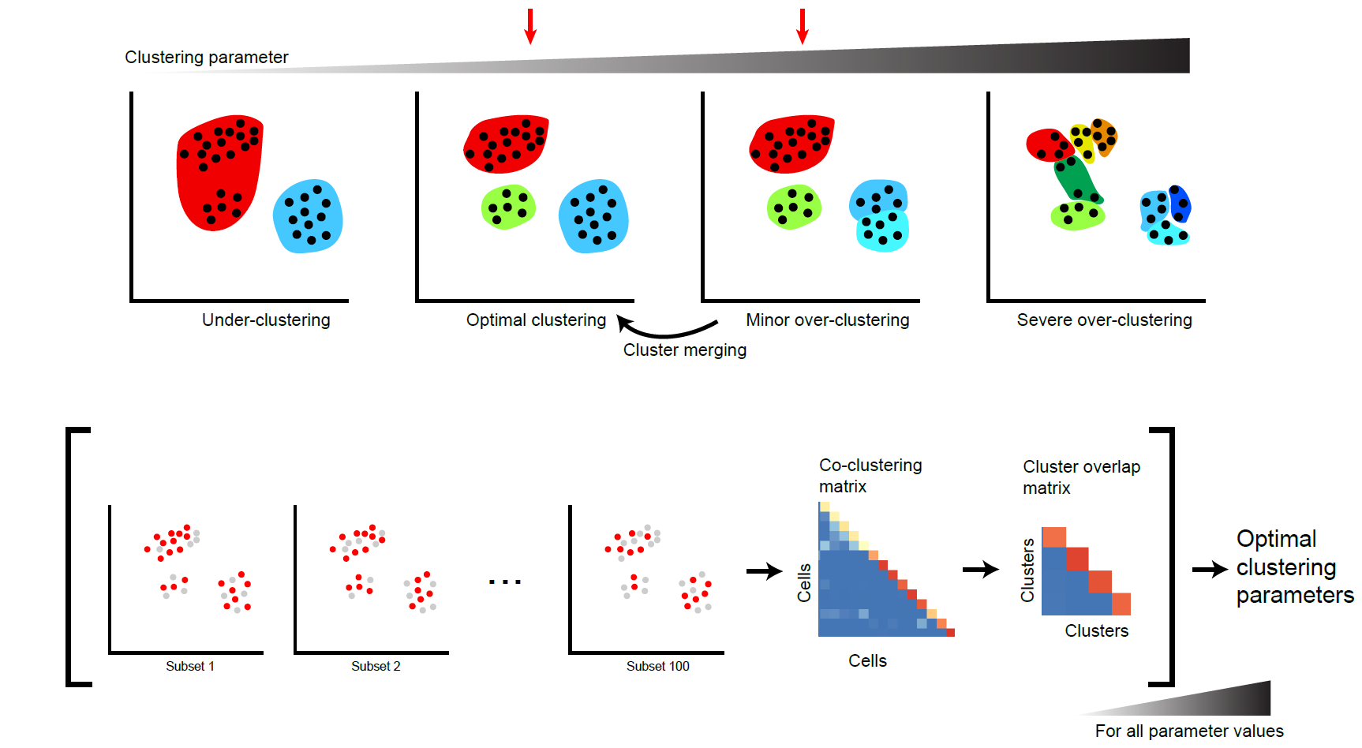
Single-cell RNA-seq clustering is sensitive to parameters
Essential to explore the parameter space!
Patterson-Cross et al. 2021

Slide 20
Standard analytical (clustering) workflow
Select genes to examine (variance-based metrics)
Reduce dimensionality
(PCA, gene clustering, autoencoders, etc.)
Select features on which to cluster
(PCs, gene modules, autoencoder nodes, etc.)
Evaluate cell-cell distances
(PC space, module space, nearest neighbor overlap)
Apply clustering algorithm
(hierarchical, graph-based, mixture models, etc.)

Slide 21
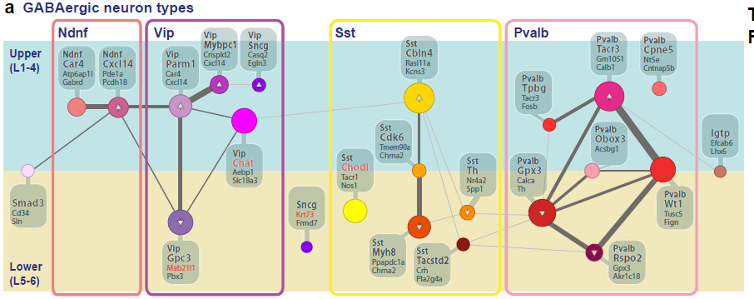
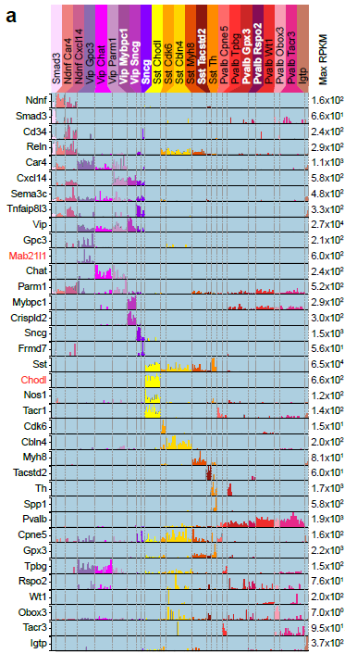
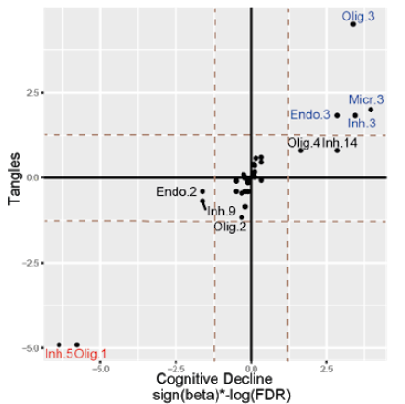
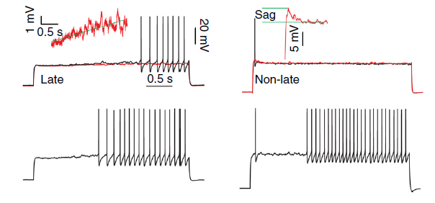
Downstream analysis of putative cell types
Differential gene expression Marker gene selection
Proposed taxonomies
Associations with perturbations or clinical phenotypes
Design of functional validation experiments
Cain et al. 2023
Tasic et al. 2016

Slide 22
Downstream analysis – disease/perturbation associations
Differential cluster representation
Differential gene expression within clusters

Slide 23
Differential cluster composition across conditions
41%
29%
29%
12%
46%
21%
21%
Methods:
scCOMP
MASC
ANCOM-BC
Milo
Quasi-binomial
…
No disease
With disease
Possibilities:
converting to
more susceptible as compared to
!! Cannot distinguish these two possibilities from static snapshots alone
!! Causality unknown

Slide 24
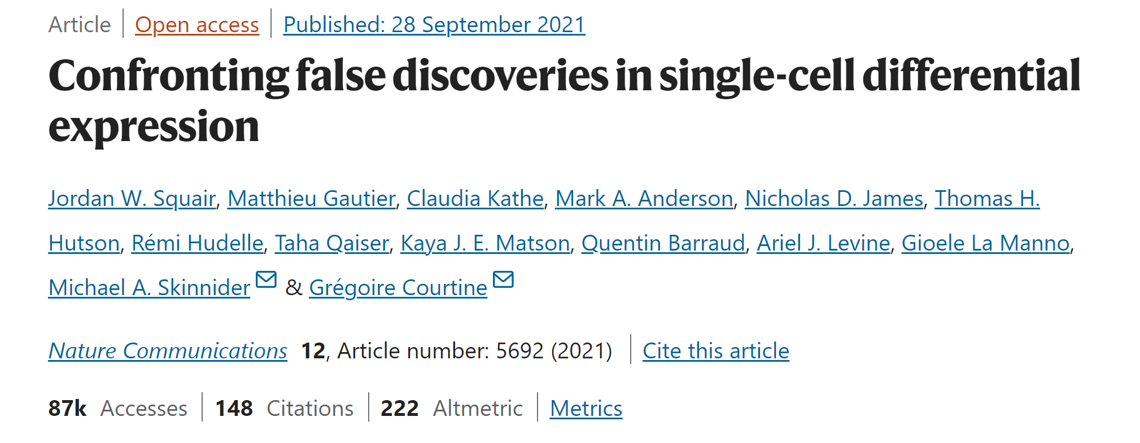
Differential gene expression across conditions
 | Test that assumes each cell is independent | Test that incorporates donor-dependence of cells
 | Standard Mann-Whitney test | Pseudobulk differential expression Mixed-effect models (e.g. NEBULA)
Which genes distinguish clusters from each other? | Can use | Can use
Which genes are differential across conditions/samples? | Avoid | Can use

Slide 25
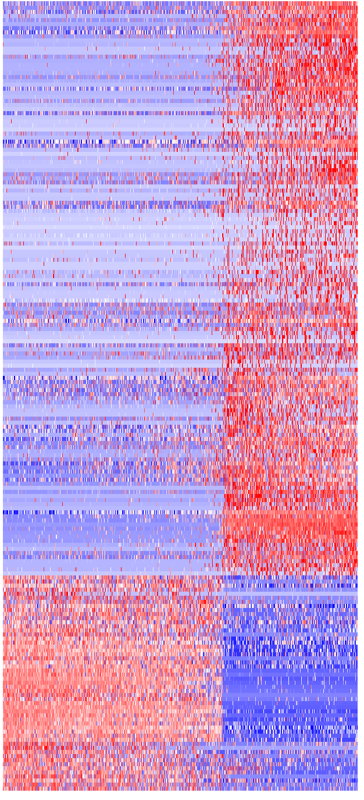
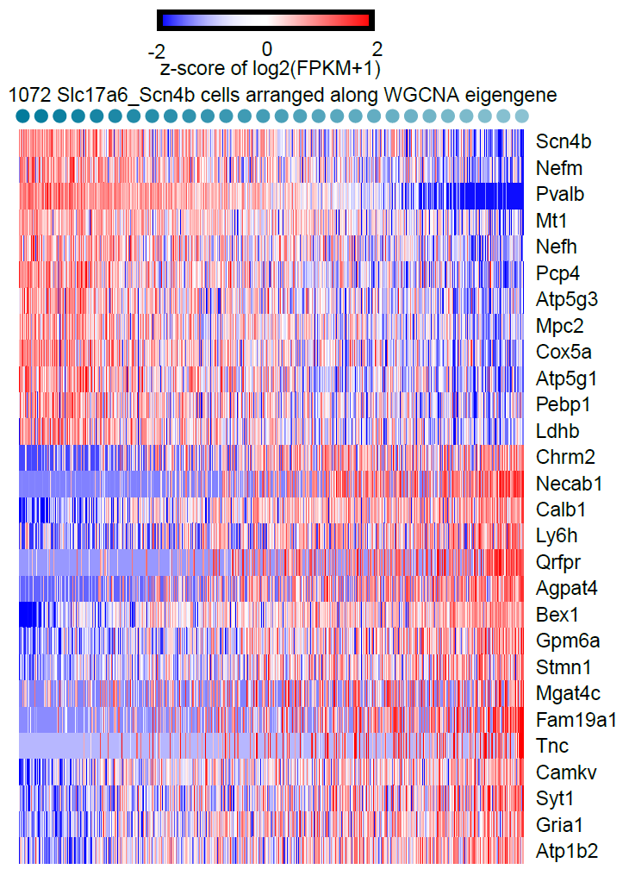
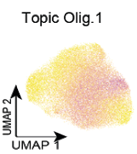
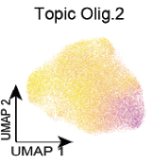
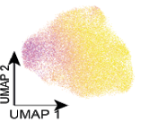
Continuous versus discrete variation
Expression
Discrete variation
Continuous variation
Heterogeneous
≠
Discrete
Continuous
Homogeneous
Genes
Expression mode 1
Expression mode 2
Expression mode 3
Cells
Cain et al. 2023

Slide 26
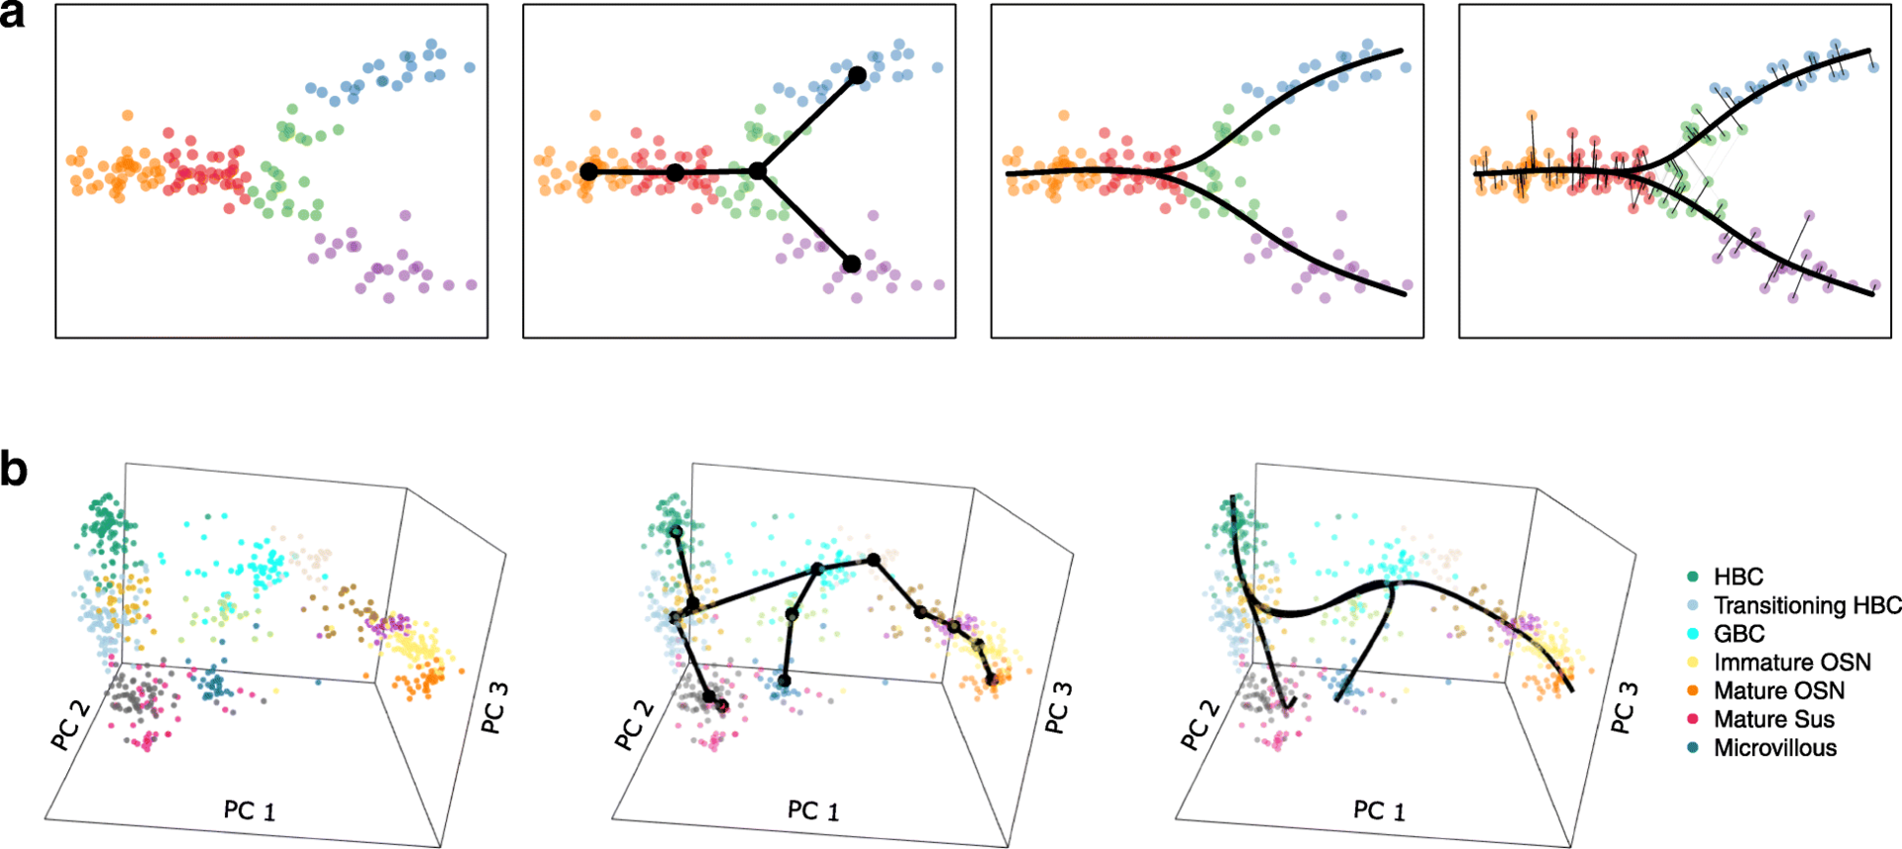
Trajectory analysis – continuous variation in time
Software packages:
Slingshot
Monocle
Waterfall
TSCAN
TradeSeq
Expression mode 1
Expression mode 2
Expression mode 3
But…not all continuous variation is a trajectory!

Slide 27
Validation of single-cell RNA-seq data
Validation assumes that RNA-seq derived distinctions are meaningful
1) Replication – are these signatures found in a separate single-cell data set?
2) Tissue validation – are signatures preserved in intact tissue?
3) Orthogonal validation – are there non-gene (protein) expression-based distinctions among putative cell types?
Spatial segregation
Physiological segregation
Functional distinctions

Slide 28
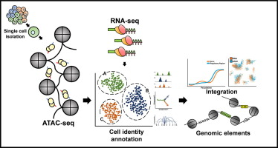
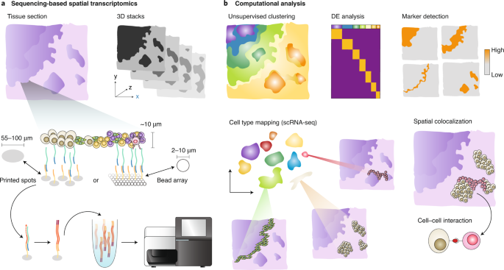
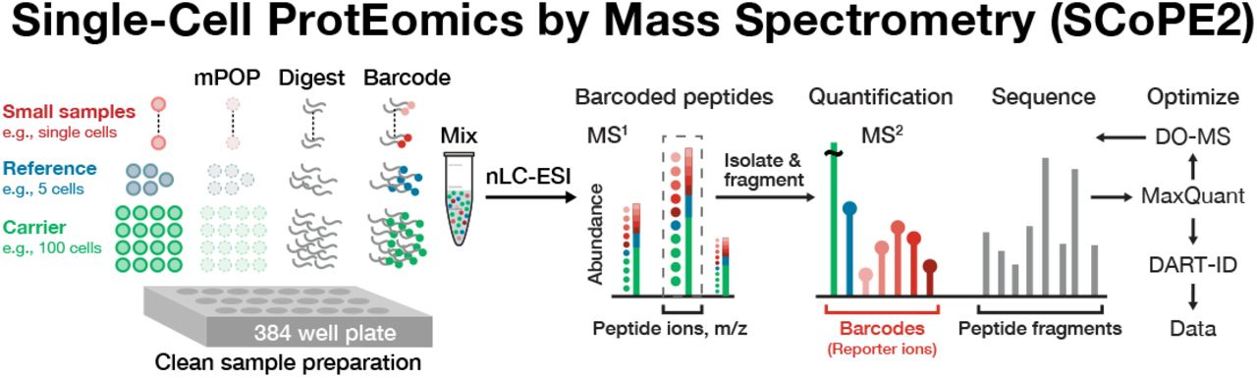
Integration with other single-cell modalities
High-resolution spatially-resolved transcriptomics
Single-cell epigenetics (ATAC-seq & methylation)
Single-cell proteomics

Slide 29
Exercise – single-cell RNA-seq clustering

Slide 30
Final presentations
Students will identify a data set (either publicly available, or generated by their lab)
Write code to analyze it with regards to a specific scientific question.
Prepare summary plots/visualizations/tables to present to the class
Any programming language can be used (R, python, MATLAB, etc.)
Each presentation will be 15 minutes long, with 5 minutes for questions afterwards

Slide 31
Final presentations
The presentation should have the following components:
Description of the biological question being asked (1 slide + more for background if needed)
Description of the data set (modality, provenance, rows/columns/size, sample number, etc.; 2-3 minutes)
Analysis workflow (supervised/unsupervised/both, main steps, parameter selection, etc.) – brief walkthrough of notebook or markdown file with code (5 minutes)
Results (figures, plots, etc.; 3-5 minutes)
Challenges/difficulties (1 slide)
Future analyses (1 slide)

Slide 32
Available data set 1: Bulk RNA-seq
This data set is extracted from the Mostafavi, Gaiteri et al. (Nature Neuroscience, 2018) paper, which used bulk RNA-seq to examine gene co-expression networks in aged individuals with and without neurodegenerative diseases. The goal of this study was to identify sets of genes associated with various pathological and clinical phenotypes.
Analyses of this subset of the data could include, but are not limited to:
1) Differential gene expression between clinical conditions and/or sex
2) Associations of genes with post-mortem interval
3) Clustering of genes into modules to identify major modes of gene expression

Slide 33
Available data set 2: single-nucleus RNA-seq
This data set is extracted from the Otero-Garcia et al. (Neuron, 2022) paper, which used single-soma RNA-seq profiling to examine differences in human cortical neurons with and without tau aggregation. Tau aggregation is a hallmark of Alzheimer's Disease, so the goal of the study was to identify differential subcluster representation and gene expression in tau-positive versus tau-negative cells.
Analyses of this subset of the data could include, but are not limited to:
1) Reclustering and gene marker discovery for clusters
2) Differential gene expression between tau-positive and tau-negative nuclei
3) Differential proportion representation of clusters in tau-positive and tau-negative nuclei

Slide 34
Available data set 3: Visium spatial transcriptomics data
This data set is extracted from the Maynard et al. (Nature Neuroscience 2020) paper, which used the Visium spatial transcriptomics platform to examine human frontal cortex tissue from 3 individuals. The original study identified layer-specific markers and potential associations with disease and other biological processes using gene enrichment analysis.
Analyses of this subset of the data could include, but are not limited to:
1) Clustering of spots to identify regions with similar gene expression
2) Associations of genes with specific spatial locations
3) Differential gene expression across layers or clusters to identify key variable genes

